Slide 1

Problem Solving Session
The remainder of today’s class will comprise the problem solving session (PSS).
Your instructor will divide you into teams of 3 or 4 students.
Each team will work together to solve the following problems over the course of 20-30 minutes.
You may work on paper, a white board, or digitally as determined by your instructor.
You will submit your solution by pushing it to GitHub before the end of class.
Your instructor will go over the solution before the end of class.
If there is any time remaining, you will begin work on your homework assignment.
Class participation is a significant part of your grade (20%). This includes in class activities and the problem solving session.
Your Course Assistants will grade your participation by verifying that you pushed your solutions before the end of the class period each day.

Slide 2
Problem Solving 1
Write a function that, given a file name, counts and returns the number of lines in the file.
def count_lines():
f = open(“a_file.txt“,”r”)
control =0
for lines in f:
control+=1
print("no. of lines:",control)
f.close()
>>> count_lines("a_file.txt")
127
>>> _
Notes:
def count_lines_in_file(filename):
try:
with open(filename, 'r') as file:
lines = file.readlines()
return len(lines)
except FileNotFoundError:
print("File not found.")
return 0
except Exception as e:
print(f"An error occurred: {e}")
return 0

Slide 3
Problem Solving 2
Def count_words():
count = 0
file = open(“a_file.txt", "r")
for line in file:
words = line.split(" ");
count = count + len(words);
print("Number of words present in given file: " + str(count))
Count_words()
Write a function that, given a filename, counts the number of words in the file. There may be more than one word per line. Some lines may be blank.
>>> count_words("a_file.txt")
29465
>>> _
Notes:
def count_words_in_file(filename):
try:
word_count = 0
with open(filename, 'r') as file:
for line in file:
words = line.split() # split on whitespace
word_count += len(words)
return word_count
except FileNotFoundError:
print("File not found.")
return 0
except Exception as e:
print(f"An error occurred: {e}")
return 0

Slide 4

Problem Solving 3
Def inp_outp():
inputfile = open("orgnl.txt", "r")
outputfile = open("dpl.txt", "w")
l = inputfile.readline()
while l:
outputfile.write(l)
l = inputfile.readline()
inputfile.close()
outputfile.close()
Inp_outp()
Write a function that, given an input filename and an output filename, copies the contents of the first file by reading it line-by-line and writing it out to the second file.
Notes:
def copy_file_line_by_line(input_filename, output_filename):
try:
with open(input_filename, 'r') as infile, open(output_filename, 'w') as outfile:
for line in infile:
outfile.write(line)
print(f"Contents copied from {input_filename} to {output_filename}.")
except FileNotFoundError:
print("Input file not found.")
except Exception as e:
print(f"An error occurred: {e}")

Slide 5
Problem Solving 4
Assume that a file contains comma-separated values that represent student grades.
Write a function that, given the name of one such CSV file, a first name, and a last name, searches the file for the correct student, calculates, and returns their lab average (grades in columns 2-9).
If the student does not exist, return None.
last name,first name,#,#,#,#,#,...
>>> lab_average("grades.csv", "Endre", "Foell")
90.5
>>> lab_average("grades.csv", "Han", "Solo")
None
>>> _

Slide 6
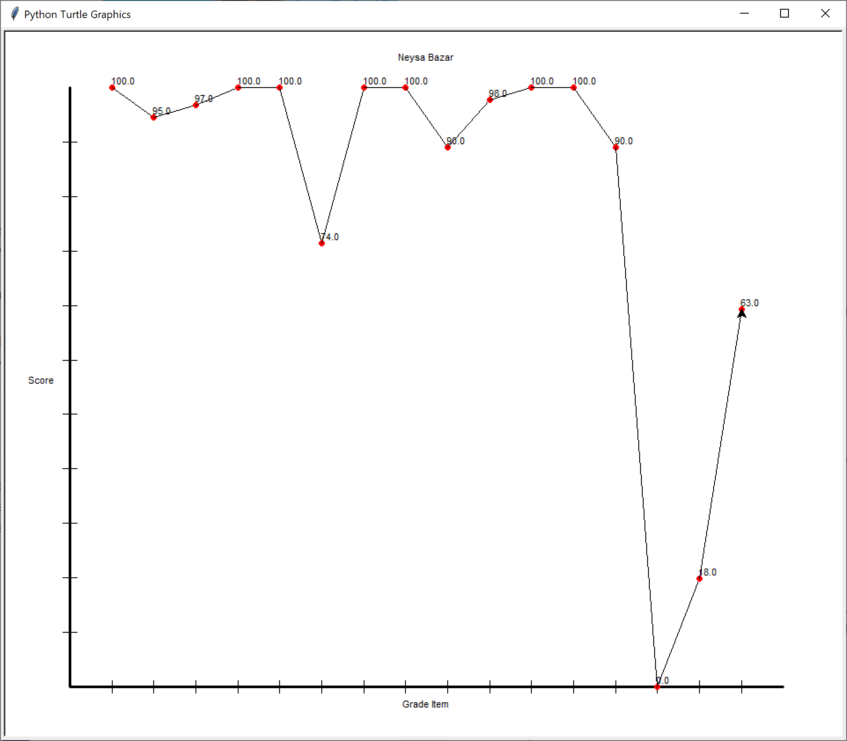
Problem Solving 5
Assume that you are continuing to work with the CSV file format described in the previous activity.
Write a function that, given a filename, first name, and last name, plots the student’s grades on a graph using the plotter module.
last name,first name,#,#,#,#,#,...

